Slide 1
BIG DATA
WELCOME
TO

Slide 2
Apache Flume
Flume is an ingestion tool for collecting aggregating and transporting large amount of streaming data
Log
Files
API Events

Slide 3
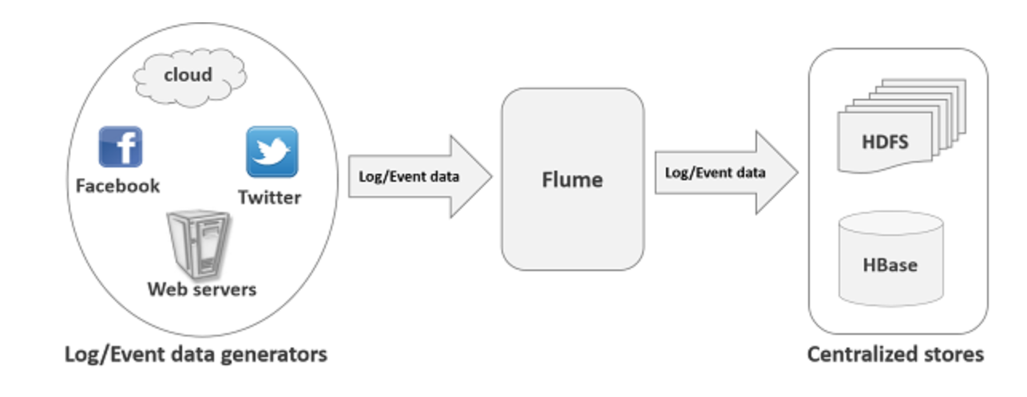
Features
Ingest data from multiple servers into HDFS or HBase
Scaled horizontally
Multi-hop Flow
Fan-out Flow
Replicating
Multiplexing
Fan-in Flow
Failure Handling

Slide 4
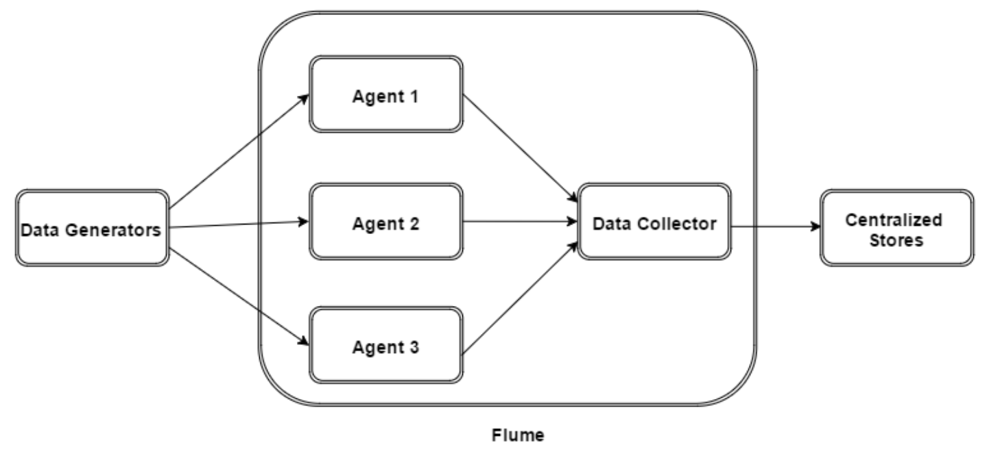
Architecture
Agent
Data Collector
Flume Event
Notes:
Agent is an independent daemon process (JVM) in Flume. It receives the data (events) from clients or other agents and forwards it to its next destination (sink or agent). Flume may have more than one agent
Data collector (which is also an agent) collects the data from the agents which is aggregated and pushed into a centralized store such as HDFS or Hbase
An event is the basic unit of the data transported inside Flume.

Slide 5
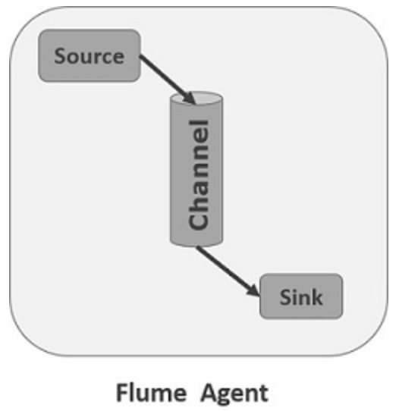
Flume Agent
Source
Channel
Sink

Slide 6
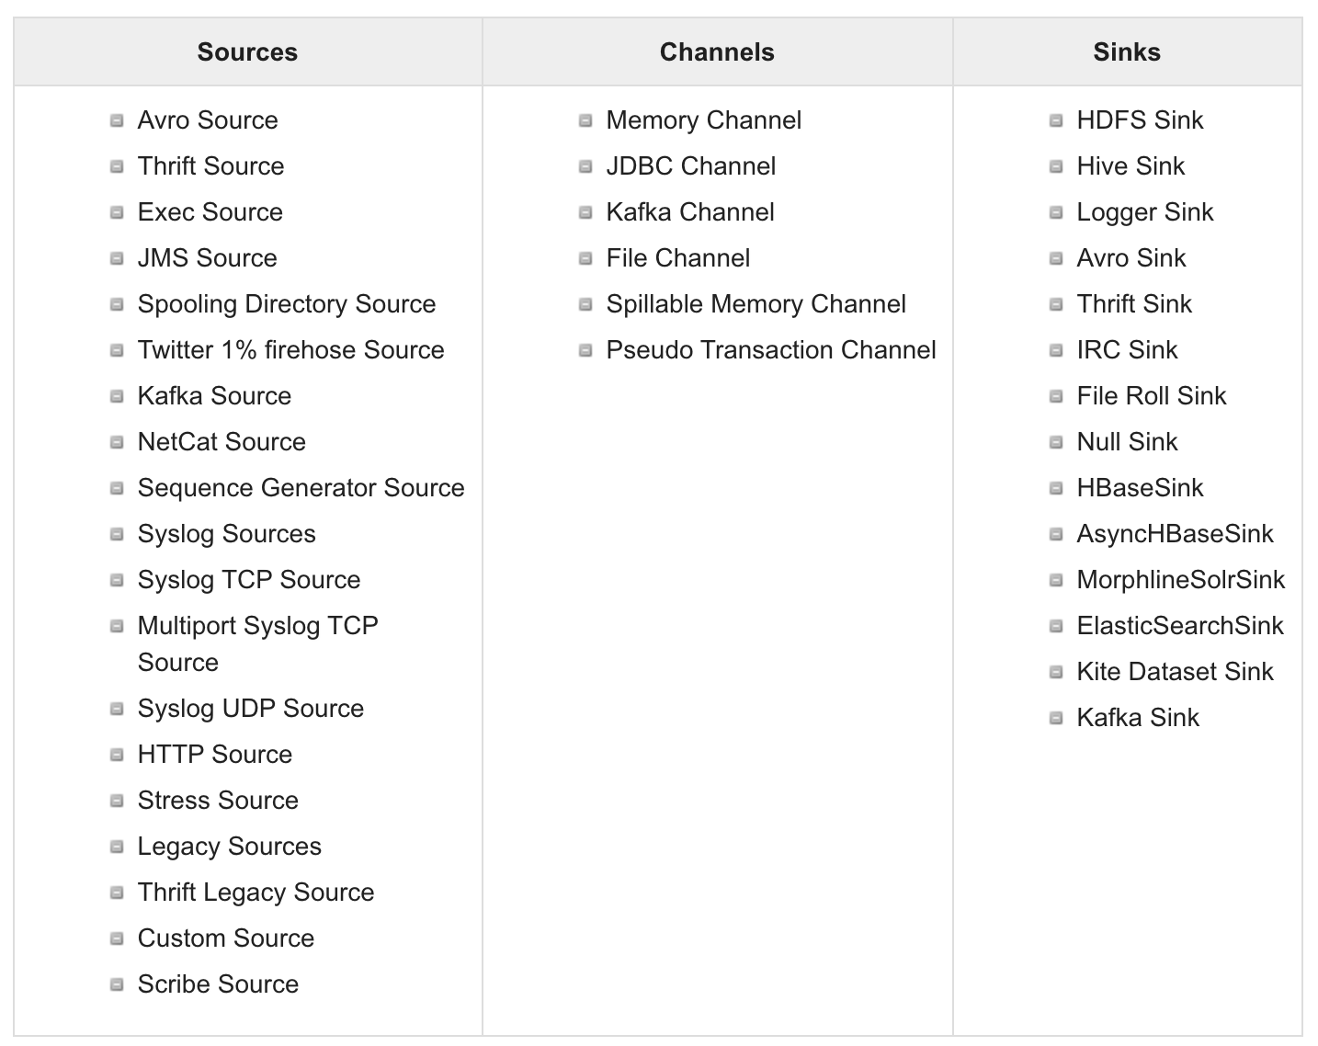
Examples

